Slide 1
Garbage Monitoring System
Group- 29
1.Amit Sharma- 2011016
2.Praveen Sharma- 2011209
3.Deepak Kapoor- 2011189
4.Saurabh Joshi -2011259
5.Ratna Prakirana- 2011211
6.Chhattlal Sahu- 2011042

Slide 2
Problem Definition
Garbage overflow is a very serious issue especially in India. It causes many health and environmental problems and destroys aesthetic value of the surroundings. Following are some critical issues related to ‘Garbage Overflow’.
Overflow of garbage due to inefficient system of garbage collection.
Street animals spill out garbage on the road.
Spilled out garbage halts the traffic in the area
Water gets mixed with garbage during rains.
Garbage on the road and remnant garbage causes foul smell.
Houseflies and mosquitoes breeding on the garbage causes diseases like malaria, dengue etc.
Overflowed garbage and garbage which spills out damages the aesthetic beauty of the place.

Slide 3
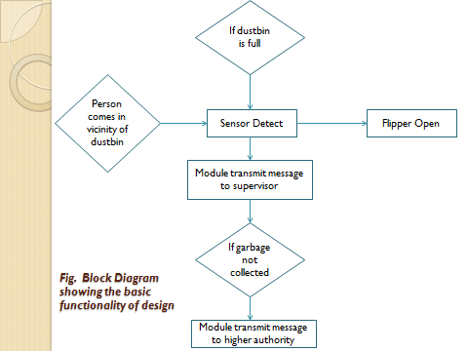
Flow Chart

Slide 4
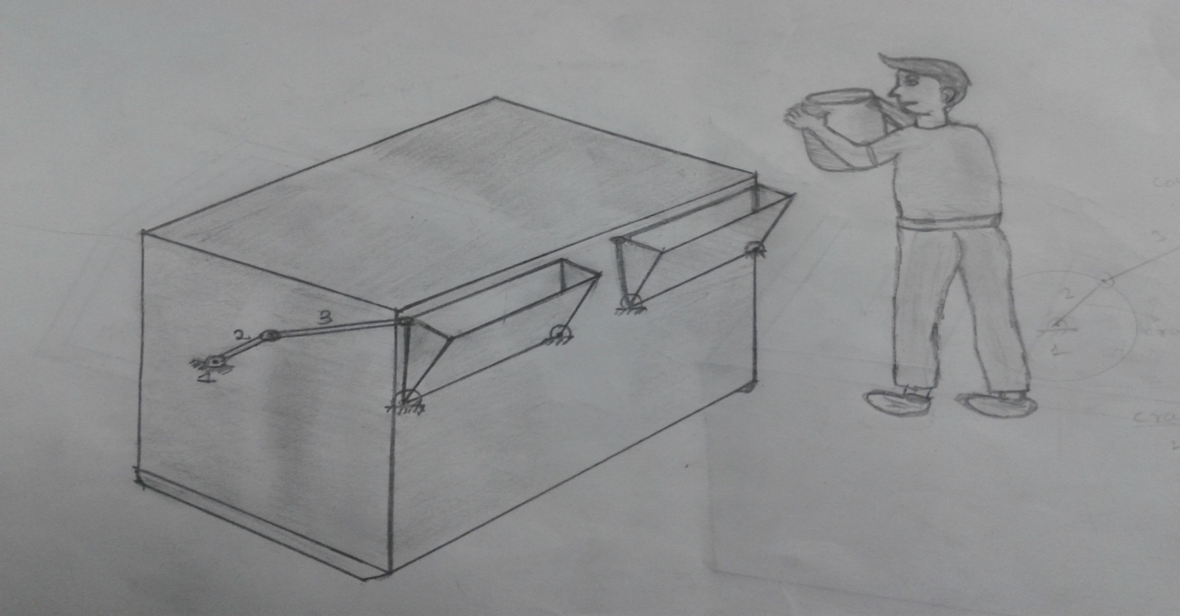
Concept Generation
Concept
Advantages-
1.Automatic.
2.Manual support , in case of power failure.
Disadvantages-
1.Power required.

Slide 5
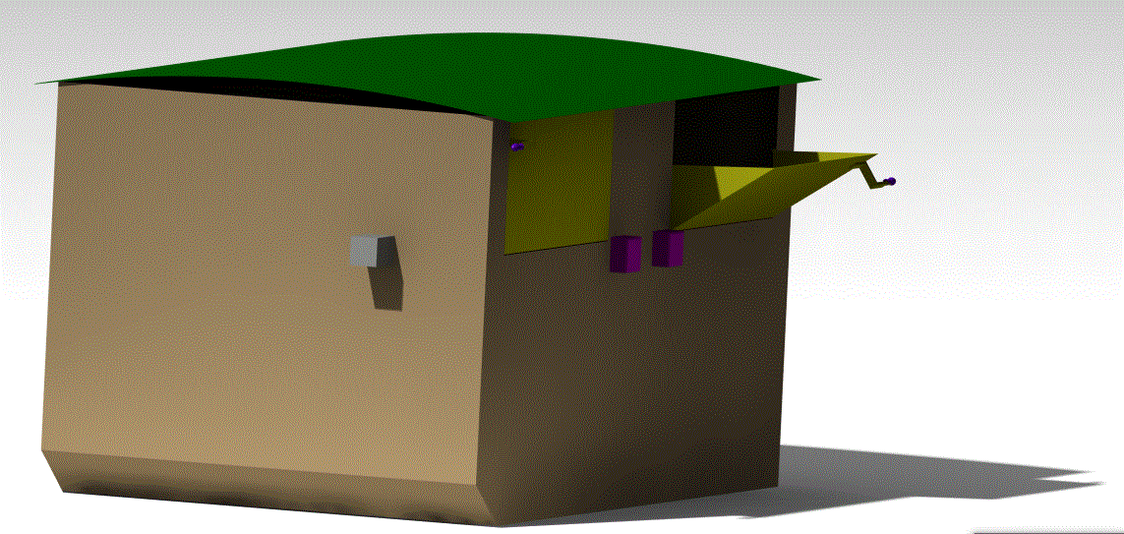
Concept CAD Model
Concept number 5 , shown in previous slide , is preferred to be the final Concept.
Fig. CAD view of Concept

Slide 6
Embodiment Design
Product Architecture:
S. NO. | COMPONENTS | FUNCTION
1. | Container | Use for garbage collection
2. | Container’s roof | Use for covering
3. | Basket | Opening and closing of garbage bin, To throw garbage
4. | 4-bar linkage | Mechanism for opening and closing of window
5. | Geared Motor | To operate 4 bar linkage
6. | Handle | To open Basket in case of power failure
7. | Hinges | For rotary motion.
8. | Bearing | Reduce friction between linkage
9. | Gate locking pin | For lock the back door
10. | At mega -16(micro controller) | For controlling various activity
11. | Back door | For taking out garbage
12. | Max-232(TTL logic convertor) | TTL Logic converter
13. | Gsm Module | For transmitting message
14. | IR Sensor | For checking Garbage is full or not
15. | Tsop Sensor module | To check vicinity of human
16. | L298 (motor driver) | To drive motor
17. | 7805 (Power regulator) | Power Regulator
18. | resistor and capacitor (.1Uf) | Parts of circuit
19. | Fecl3 | For etching
20. | Printed circuit board | To Print the circuit
21. | Adapter12V | For supplying power to circuit.
22. | Li-ion cell | For circuit operating

Slide 7
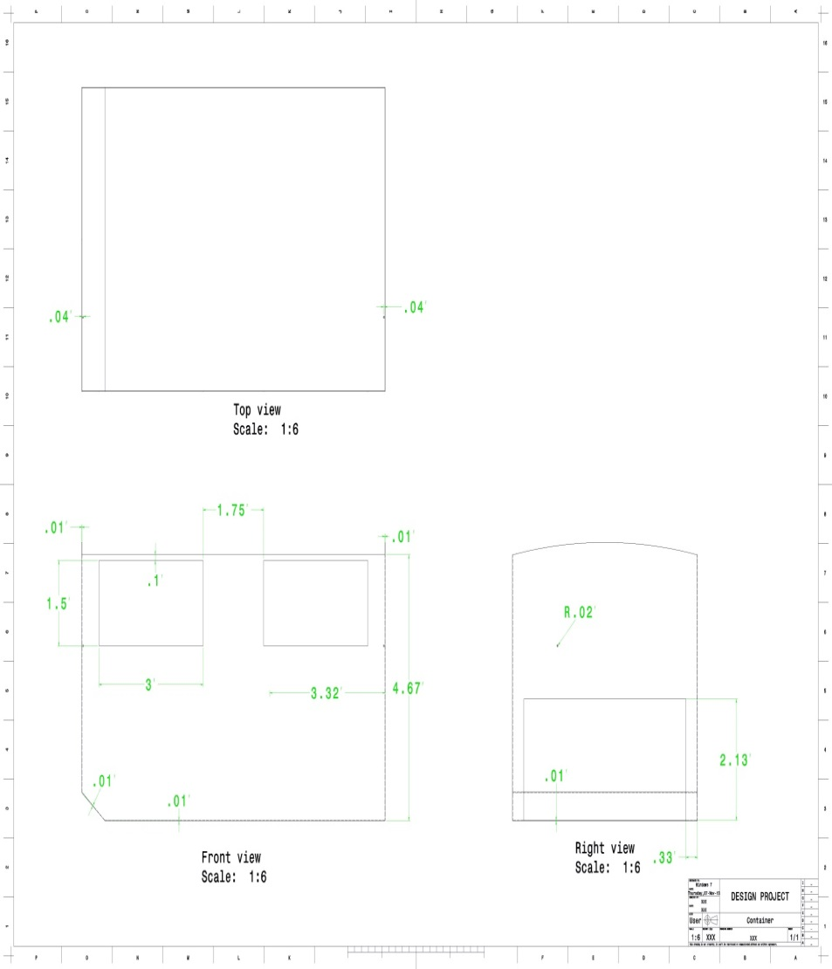
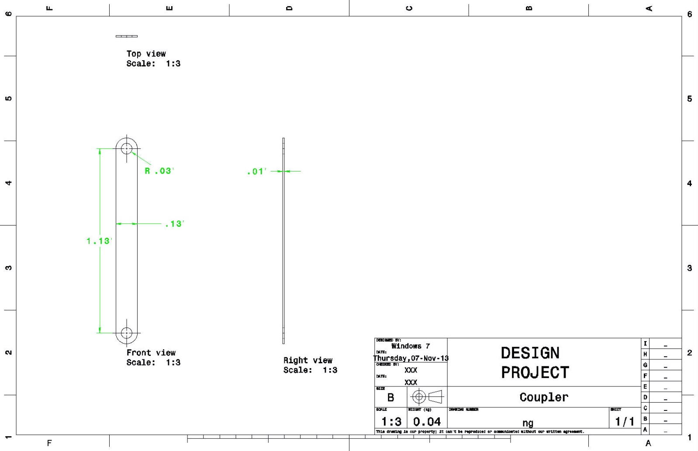
Parametric design
Container
Coupler

Slide 8
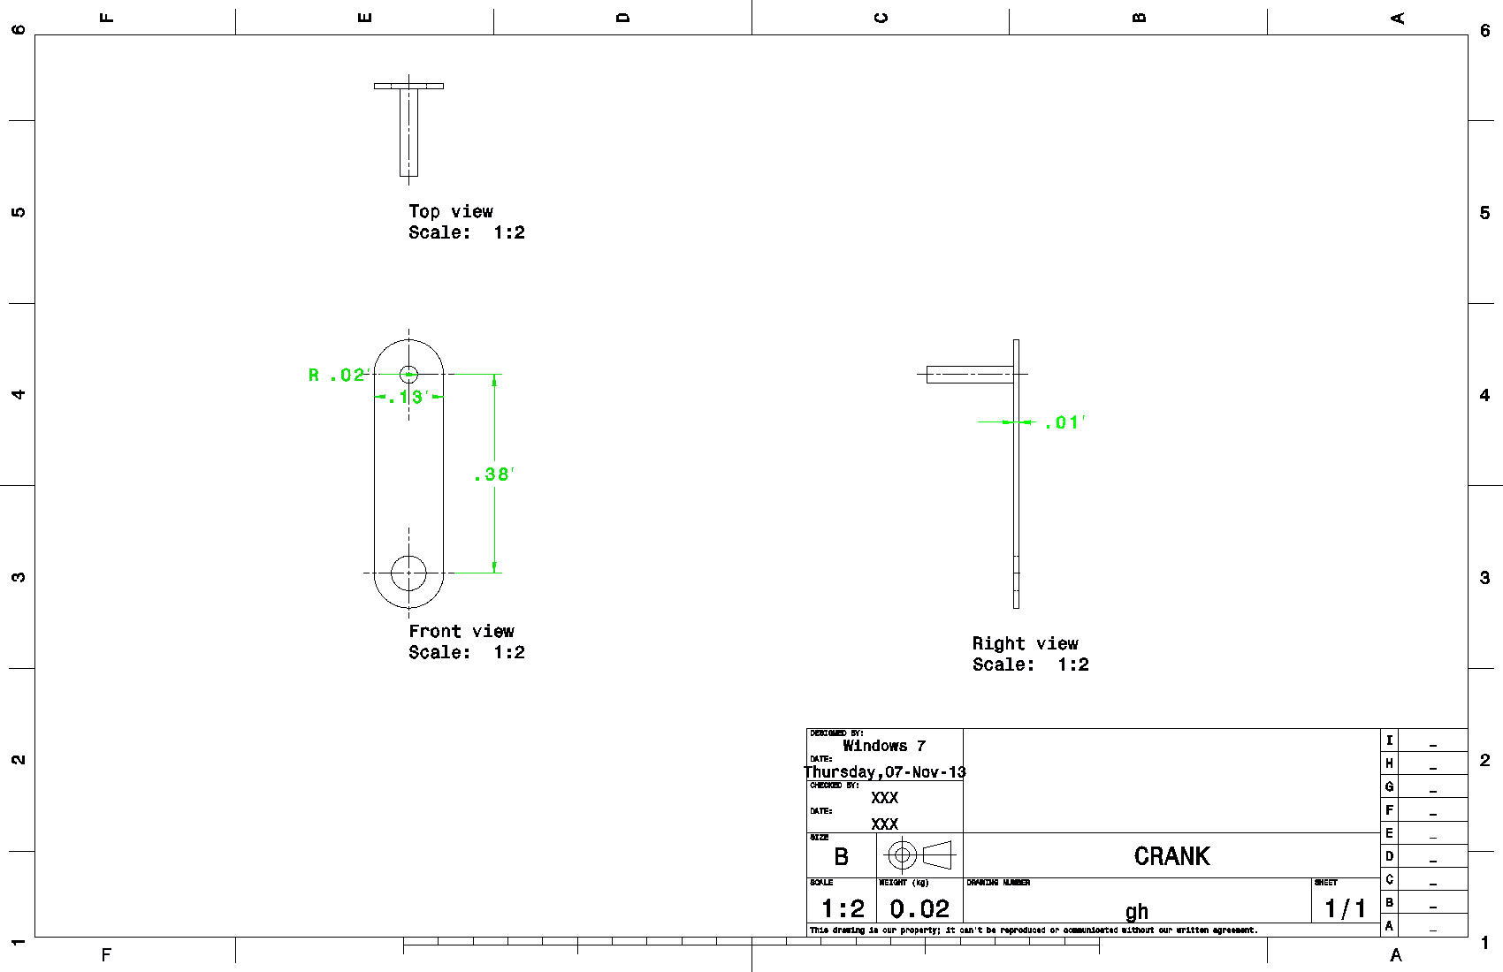
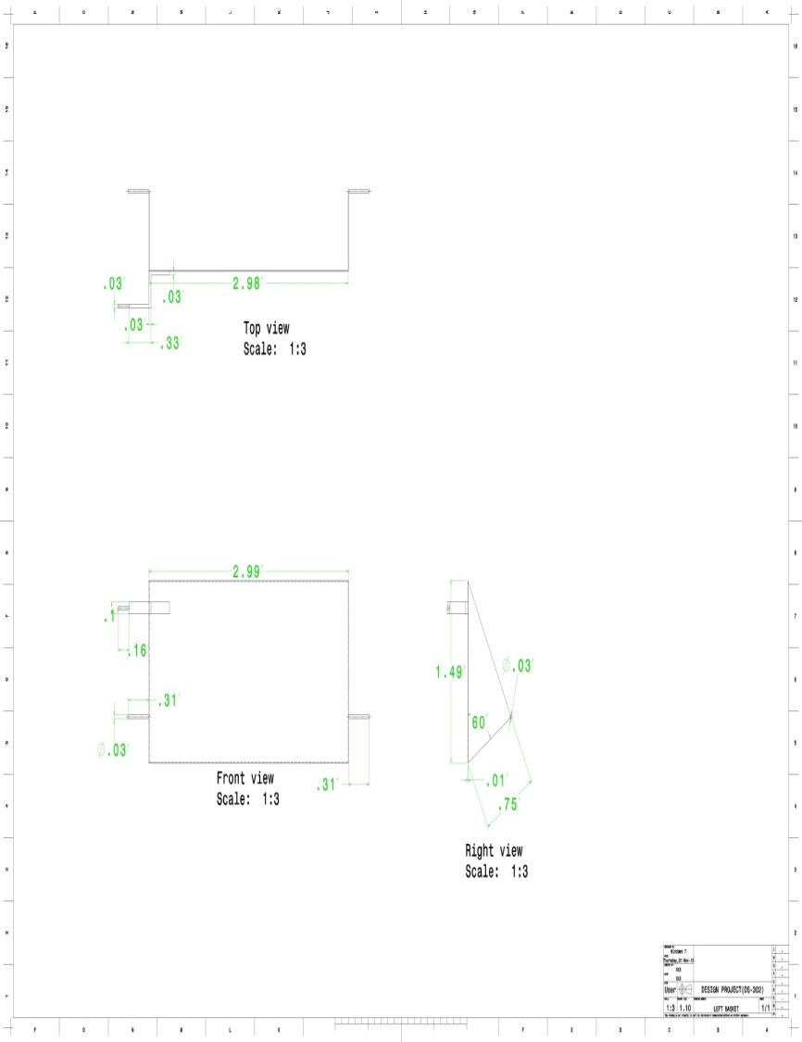
Continued…
Crank
Left Basket

Slide 9
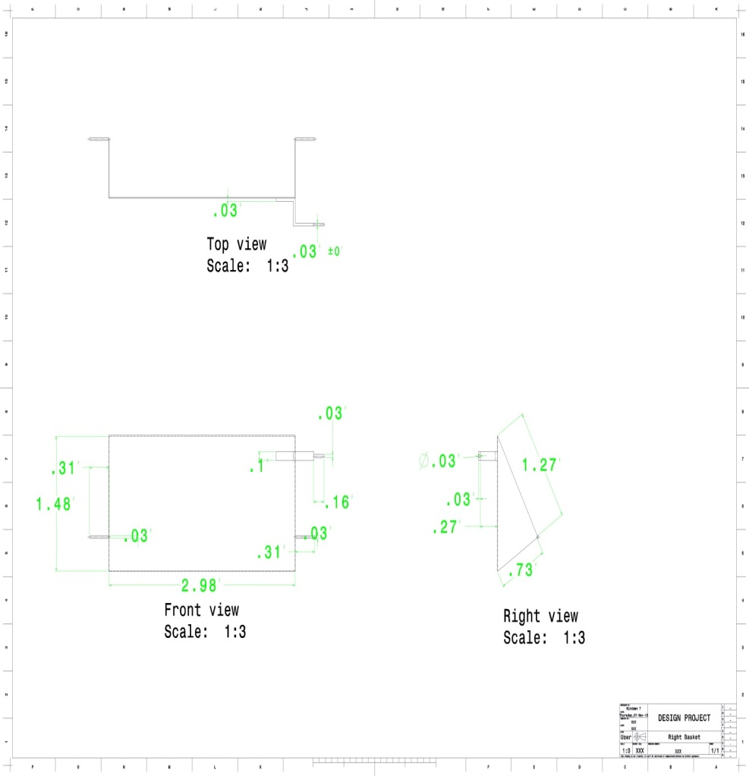
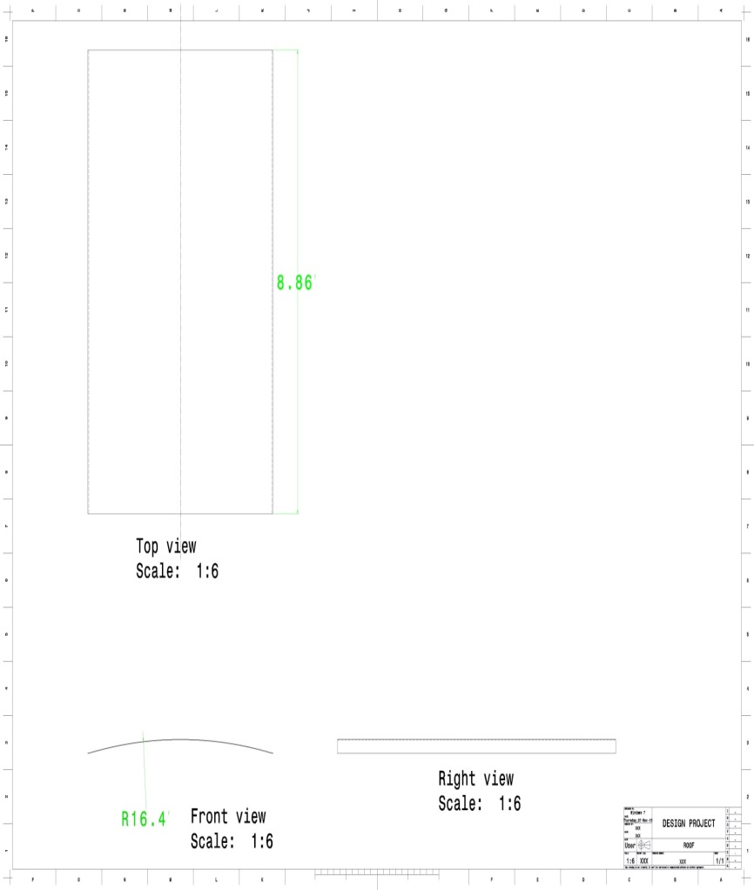
Continued…
Right Basket
Roof

Slide 10
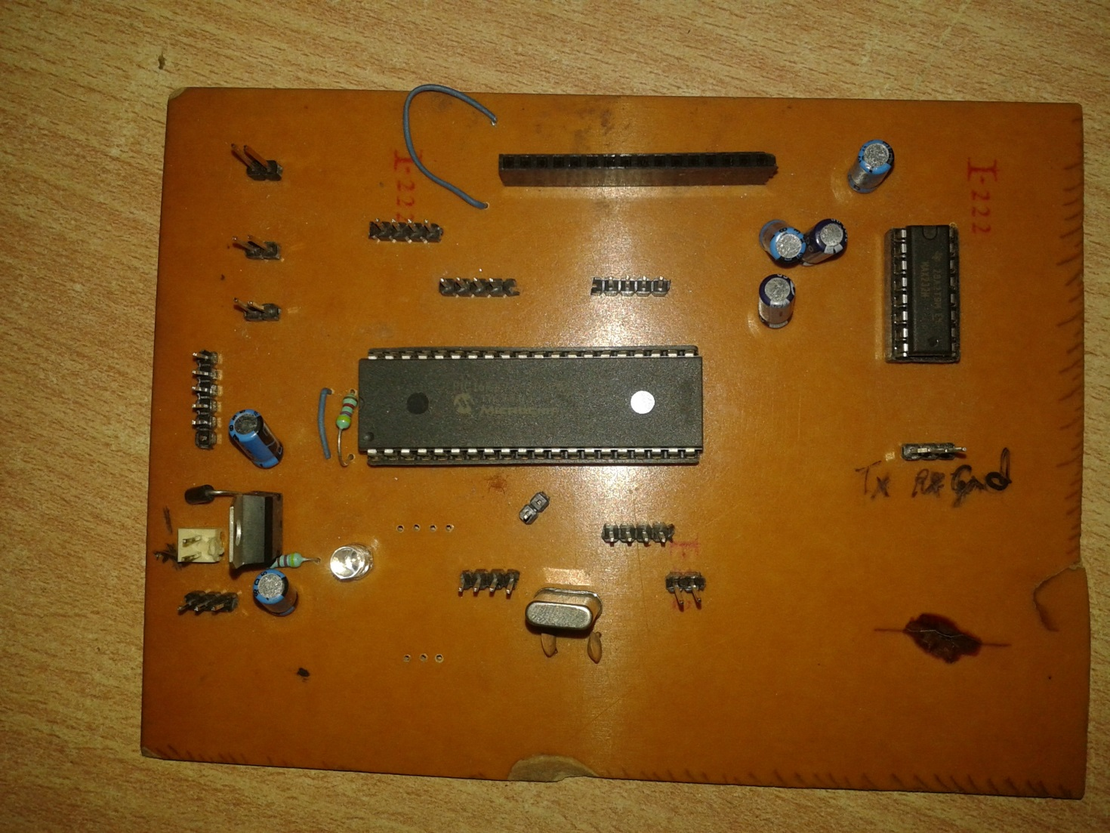
Prototype
Circuit design

Slide 11
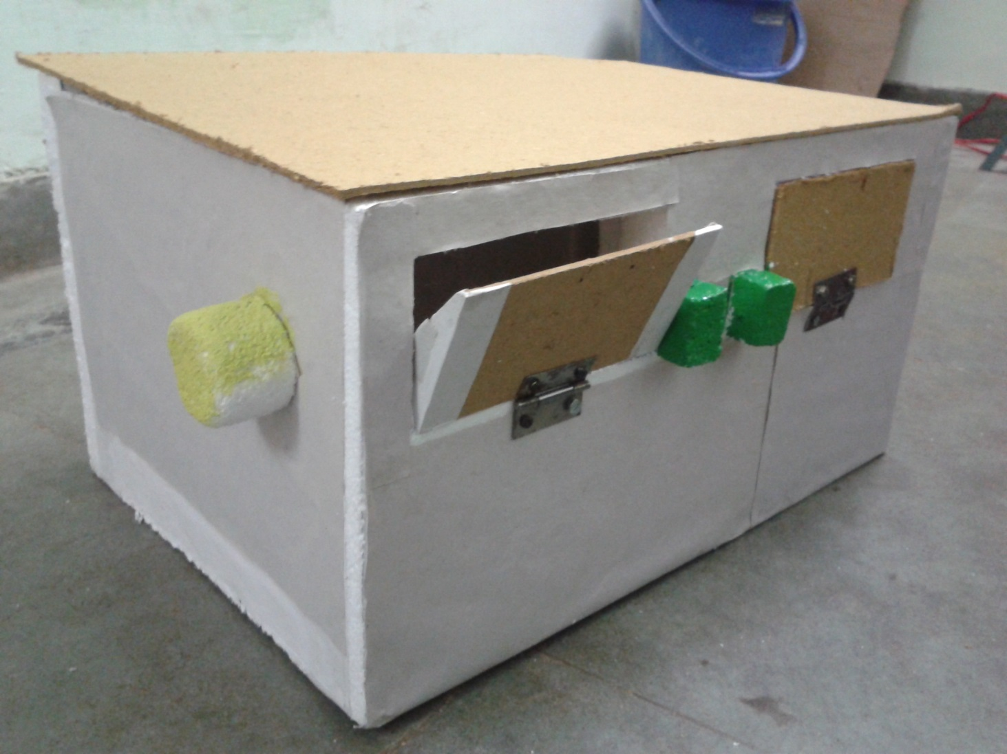
Prototype
Isometric View

Slide 12
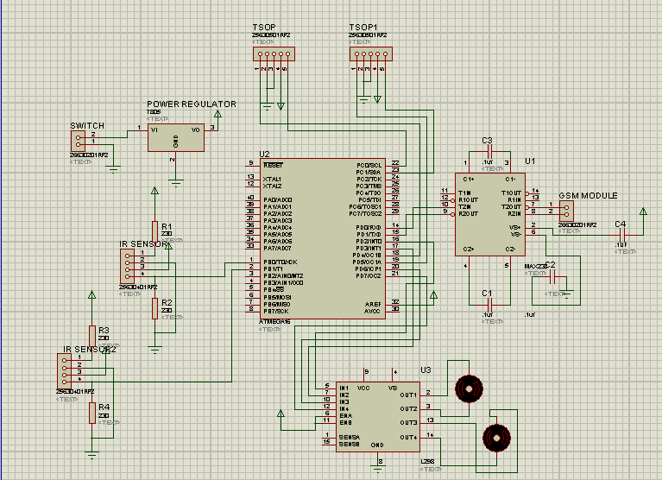
Circuit Design

Slide 13
Standard Parts Vendors
Geared Motor(30 rpm)
Lever
Atmega -16
Back door
Max-232
Gsm Module
IR Sensor
Tsop Sensor
L298
7805
Register and capacitor (.1Uf)
Fecl3
Pcb
Adapter
S.no. | Name | Address
1. | Nex Robotics | Airoli , Mumbai
2. | Probots Techno Solutions | NagarBhavi Main Road ,Bangalore
3. | Robomart | Nithari Branch, Noida
4. | Bhavani Plywood | City Cofee House ,Jabalpur
5. | Mehta Electronics | Karam Chand Chowk , Jabalpur
6. | Robosystems | Online
7. | Gujrat Hardware | Jabalpur

Slide 14
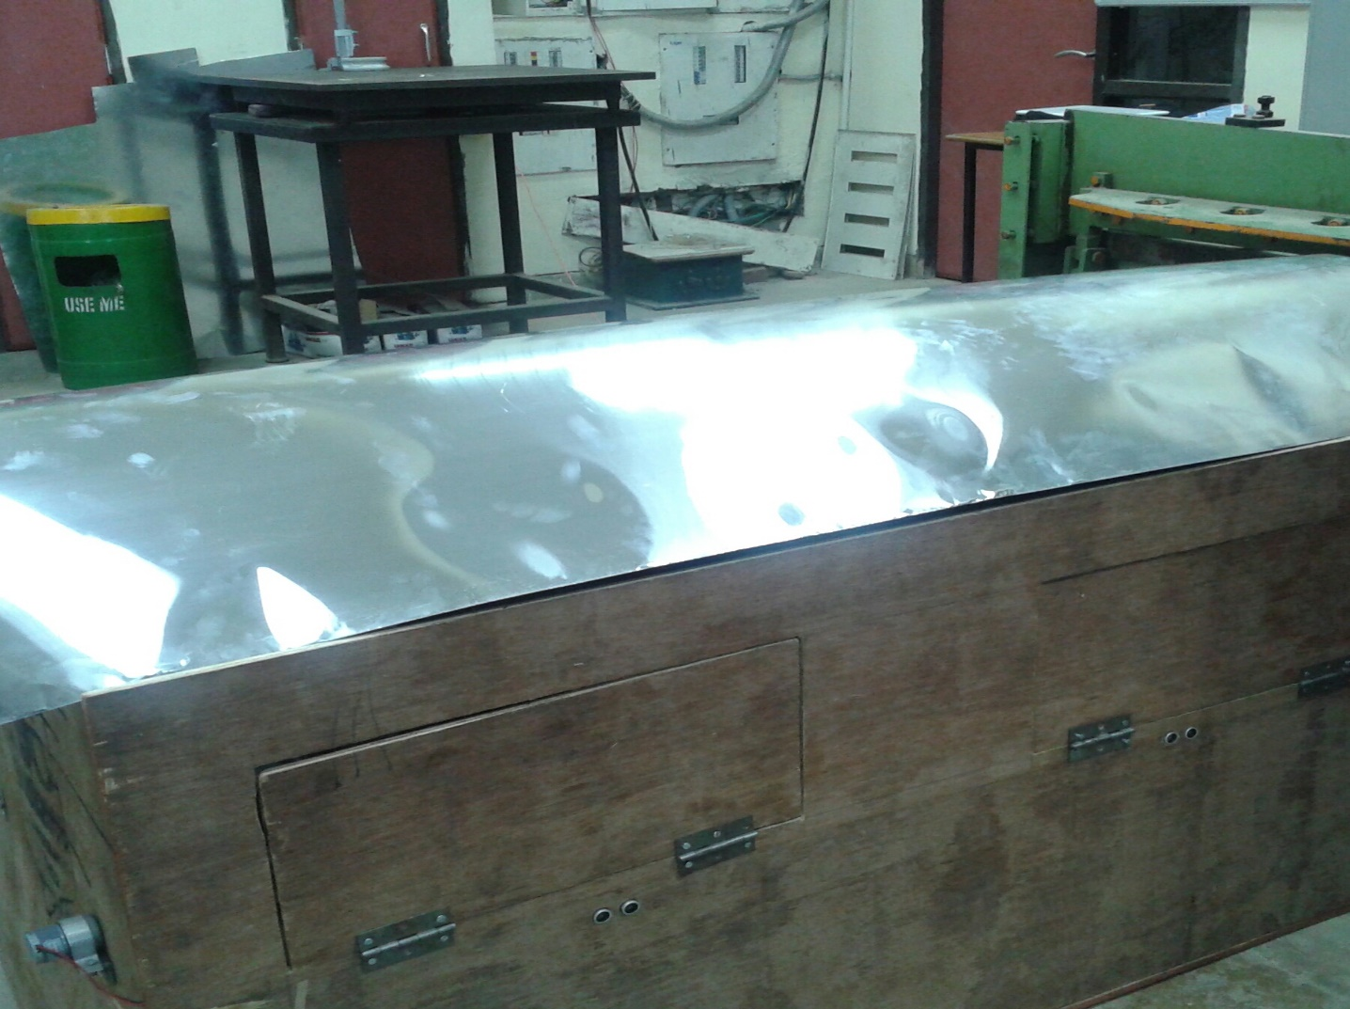
Fabrication

Slide 15
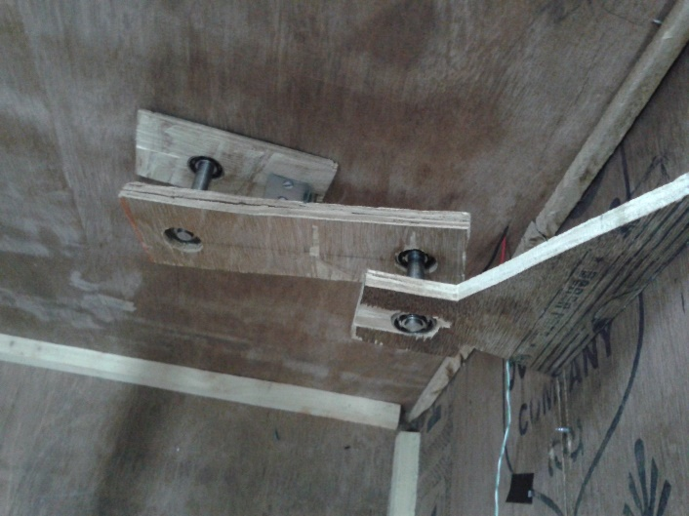
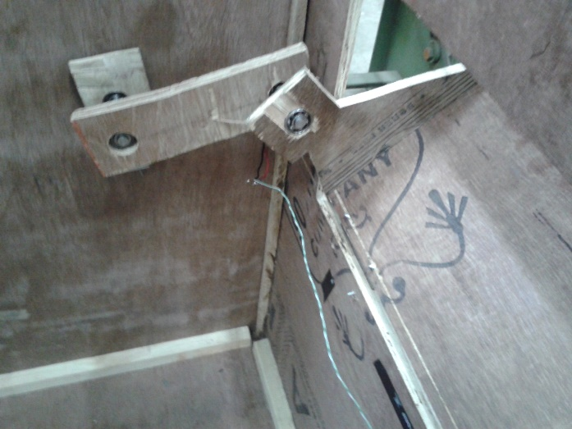
Fabrication
Crank-rocker mechanism is used .Rocker angle is 45-50 degree. There are total 4-linkage in mechanism.Links are connected with revolute joints. Bearing are used to make bearing (internal Diameter = 10mm, External Diameter = 24mm).
Shaft is used to connect two bearing so revolute joint can be made.

Slide 16
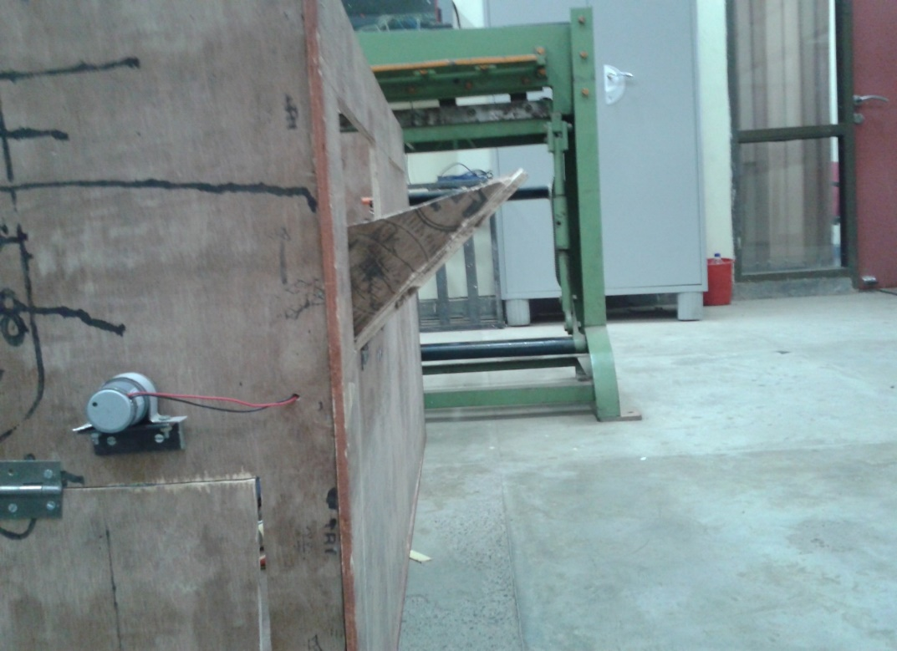
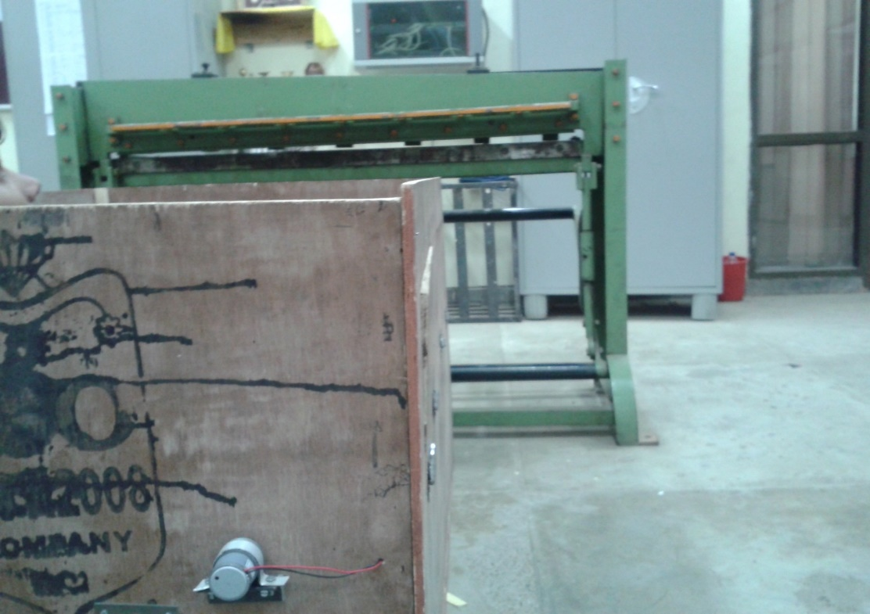
Fabrication
External View -
Window gets open once a person come to throw
the garbage.
Window gets closed automatically after few seconds.

Slide 17
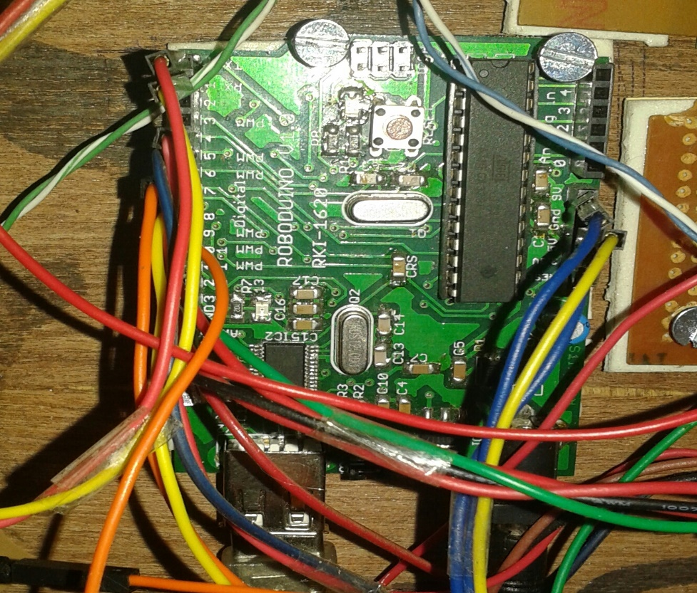
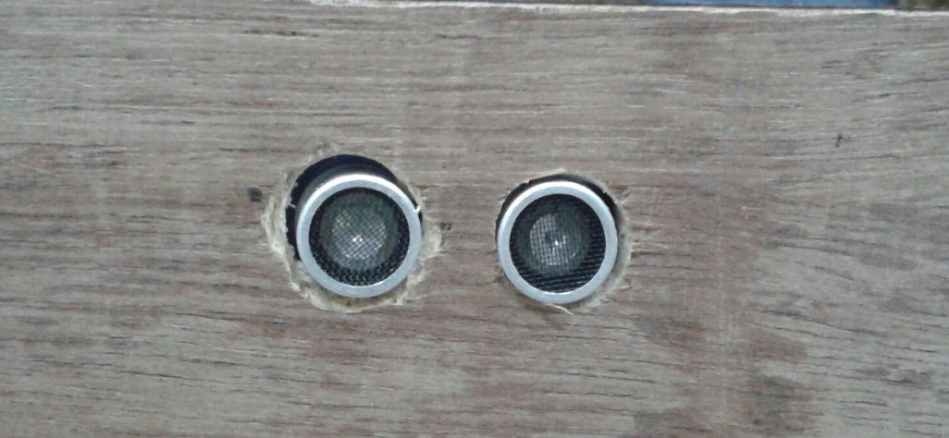
Ultrasonic sensors (mounted) to detect the presence of a person . Maximum range over which it can detect the presence is 3 meters and an angle of 15 ⁰.
Fabrication
Components Used -
Ultrasonic Sensor send the message to the Arduino Atmega32 (controller) and controller actuates the motor and it give AT command to GSM to send message.

Slide 18
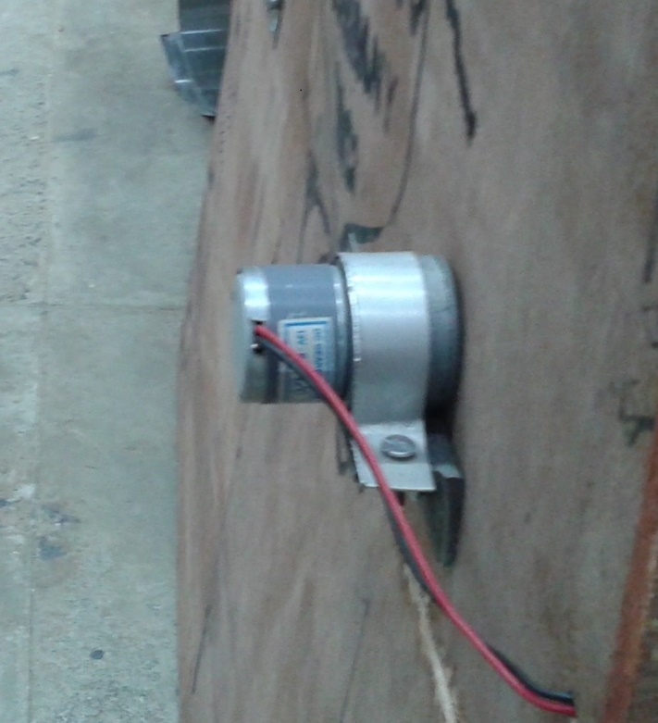
Motor is fixed to side wall of bin and motor shaft is connected to crank of mechanism.The RPM of motor is 30 and torque is 5kg/cm. and operate at 10V , .5A current
Fabrication
Components Used -
Ultrasonic Sensor send the message to the Arduino Atmega32 (controller) and controller actuates the motor and it give AT command to GSM to send message.

Slide 19
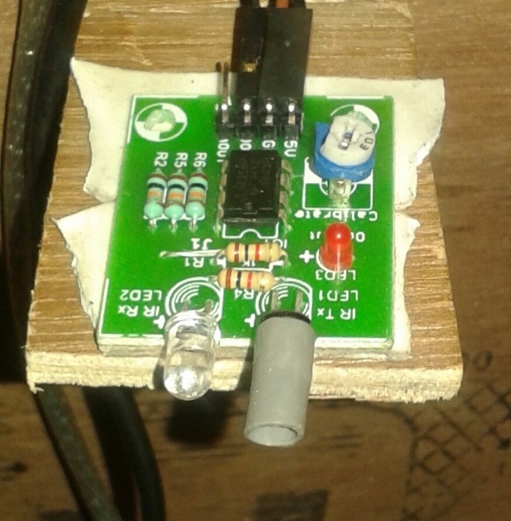
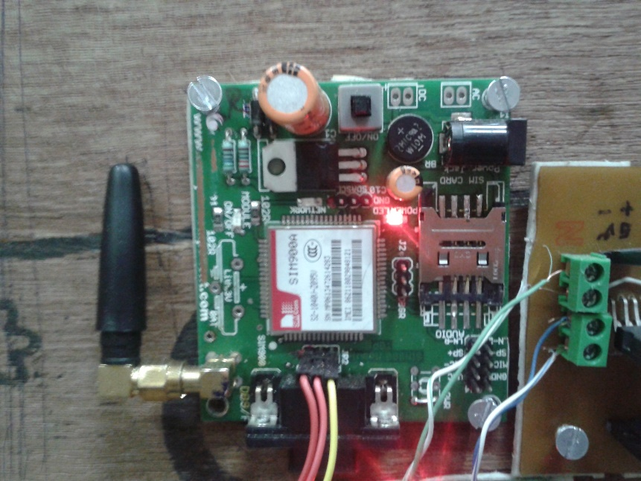
This IR sensor detects whether the garbage bin is full or not and it sends signal to the controller. The range is 6 cm
Fabrication
Components Used -
GSM SIM900A module receives the signal from the controller and then sends message to the respective authority.

Slide 20
Product Analysis
Problems -
Sensor cannot differentiate between human beings and big animals.
Bearings need time to time maintenance.
Due to network problem some times alert message can not be send.
Future Scope -
The Dustbin can be made renewable by using lithium ion battery and sonar Panel. The Garbage Bin will the be operated by sunlight.

